Slide 1
Apache Spark: Beyond Hadoop MapReduce

Slide 2
Agenda
At the end of this webinar you will be able to know about:
Strength of MapReduce
Things beyond MapReduce
How MapReduce limitations can be overcome
How Spark fits the bill
Other exciting features in Spark

Slide 3

Strength of MapReduce

Slide 4

Strength of MapReduce
Simple
Independence of language of choice, such as Java, C++ or Python.
Minimal
data
motion
Scalability
process petabytes of data, stored in HDFS on one cluster
Process moves towards data to minimize disk I/O
Fault
Tolerance
MapReduce takes care of failures using the replicated copies.

Slide 5

Limitations Of MapReduce (MR)

Slide 6

Limitations Of MR
Real
Time
Random
Access
Graph
Processing
Minimal
Data
Motion
Iterative
Tasks
Complex
Algorithm
Re-reading
And parsing
Data

Slide 7
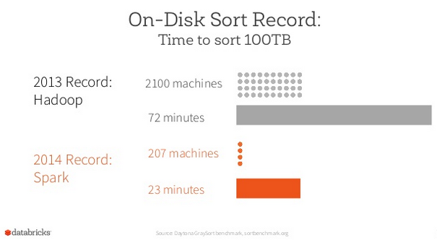
Feature Comparison with Spark
Hadoop MapReduce
HADOOP Spark
Fast | 100x faster than MapReduce
Batch Processing | Batch and Real-time Processing
Stores Data on Disk | Stores Data in Memory
Written in Java | Written in Scala
Source: Databrix

Slide 8
How MR limitations can be overcome

Slide 9

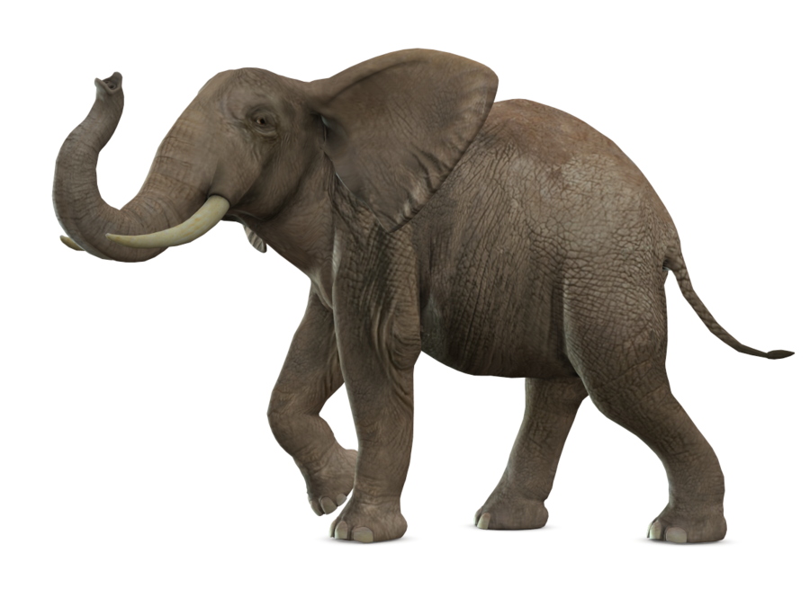


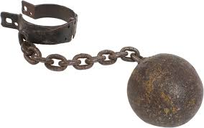
Overcoming MR limitations
Overhead
Reading,
parsing
Real
time
Cutting down on the number of reads and writes to the disc

Slide 10
Overcoming MR limitations
complex
algorithm
Graph
processing
Libraries for Machine learning, Streaming

Slide 11
Overcoming MR limitations
Iterative
tasks
Random
access
Cyclic data flows

Slide 12

How Spark Implements Features To Make Its Architecture Better Than MR

Slide 13

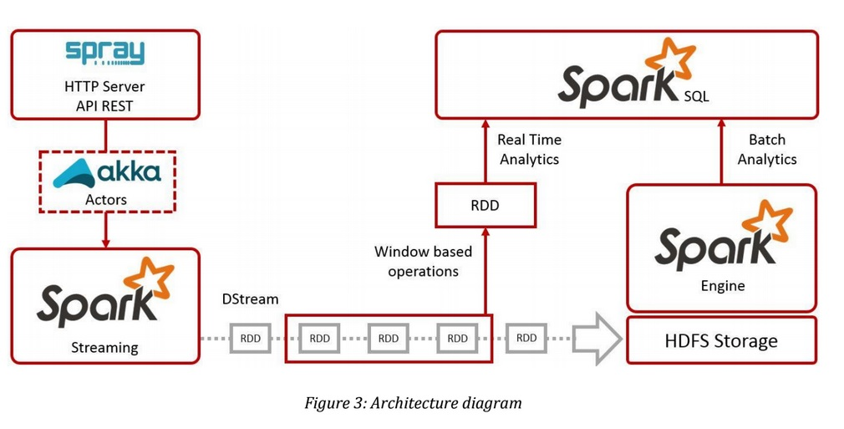
Sparks Cuts Down Read/Write I/O To Disk
Spark tries to keep things in-memory of its distributed workers, allowing for significantly faster/lower-latency computations, whereas MapReduce keeps shuffling things in and out of disk.

Slide 14
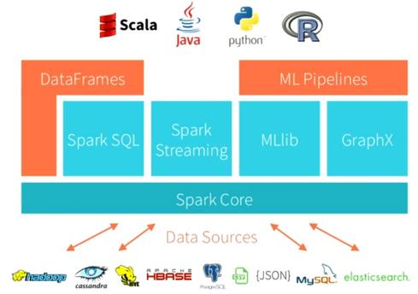
Libraries For ML, Graph Programming …
Utility for continues ingestion of data
Graph programming
Spark interface
For RDBMS lovers
Machine Learning
Library

Slide 15
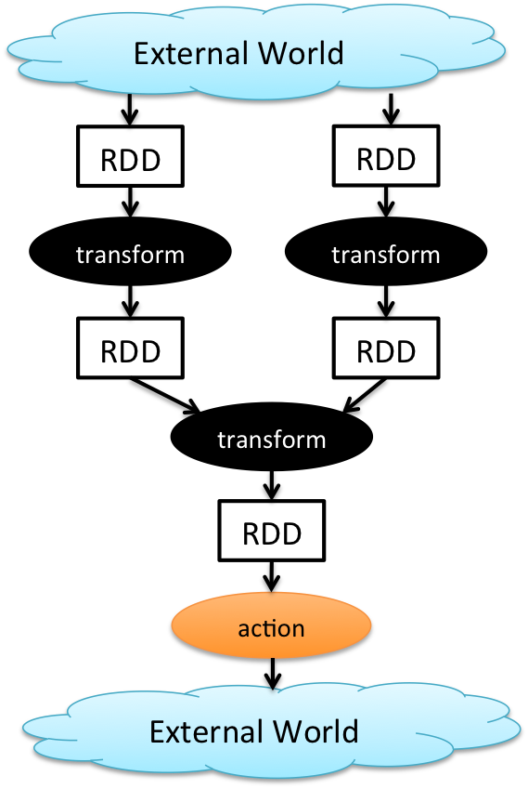
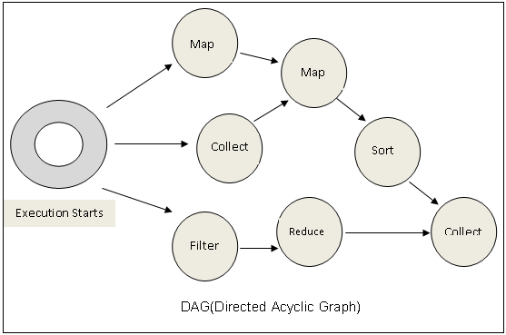
Cyclic Data Flows
All jobs in spark comprise a series of operators and run on a set of data.
All the operators in a job are used to construct a DAG (Directed Acyclic Graph).
The DAG is optimized by rearranging and combining operators where possible.

Slide 16
Spark Other Features In Demand

Slide 17
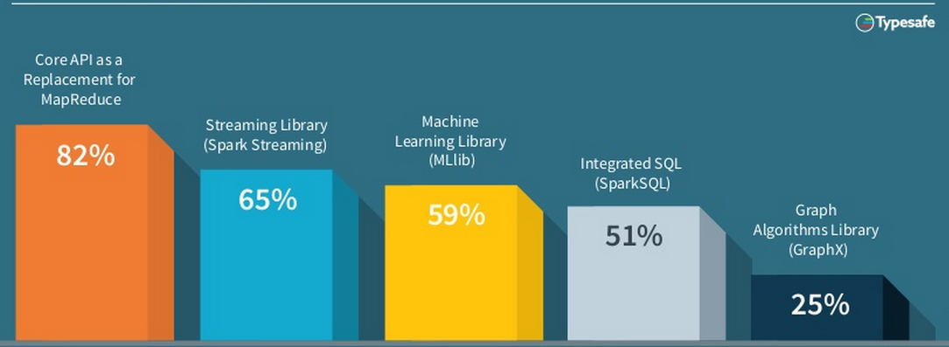
Spark Features/Modules In Demand
Source: Typesafe

Slide 18

New Features In 2015
Data Frames →
Similar API to data frames in R and Pandas
Automatically optimised via Spark SQL
Released in Spark 1.3
SparkR →
Released in Spark 1.4
Exposes DataFrames, RDD’s & ML library in R
Machine Learning Pipelines →
High Level API
Featurization
Evaluation
Model Tuning
External Data Sources →
Platform API to plug Data-Sources into Spark
Pushes logic into sources
Source: Databrix
Notes:
http://www.information-management.com/gallery/Big-Data-Hadoop-2015-Predictions-Forrester-10026357-1.html
https://www.forrester.com/Predictions+2015+Hadoop+Will+Become+A+Cornerstone+Of+Your+Business+Technology+Agenda/fulltext/-/E-RES117705

Slide 20
Survey

